Slide 1
Distributed Multi-Agent Model for Air Traffic Flow Management Simulation
University of Minho
Kim Ang Kheang^{1,2}, César Analide^{2,*}, and Filipe Manuel^{2,*}
¹ Royal University of Phnom Penh, Phnom Penh, Cambodia
kimangkheang@gmail.com
² University of Minho, Braga, Portugal {B7646@ecsaude, analide@di}.uminho.pt

Slide 2
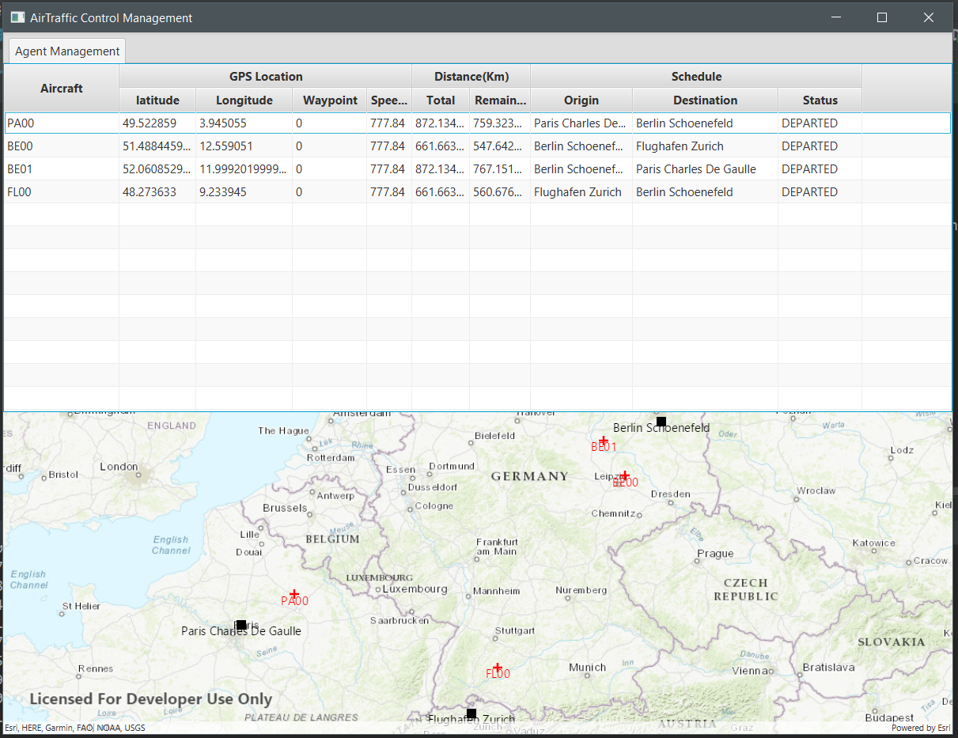
Introduction

Slide 3
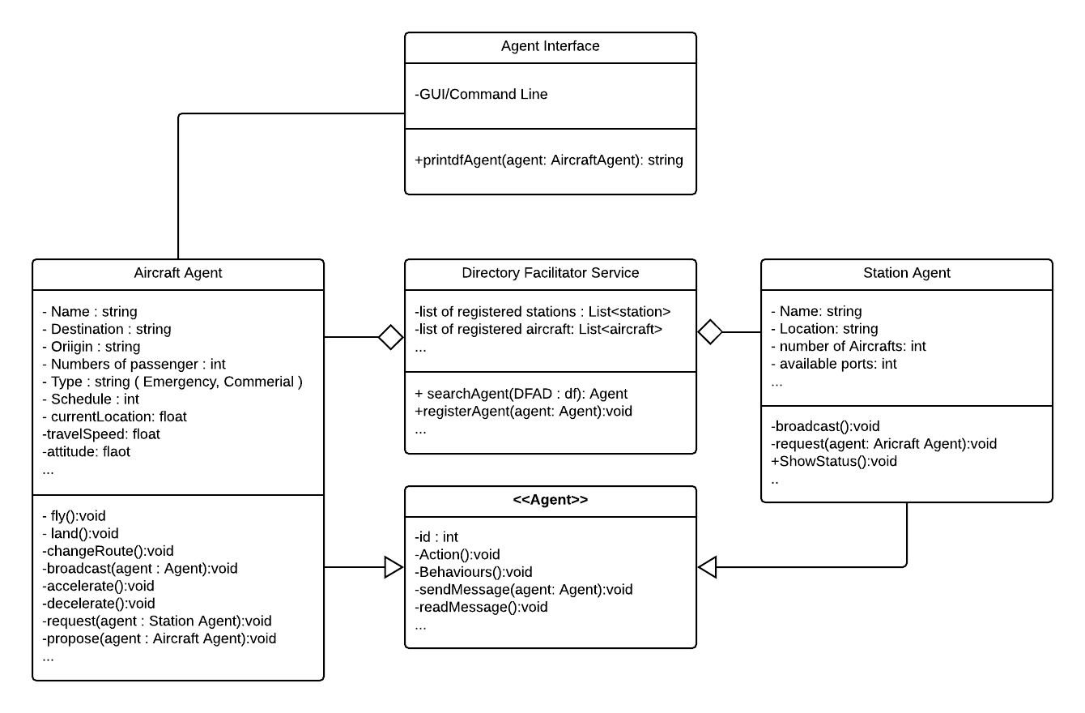
Class hierarchy

Slide 4
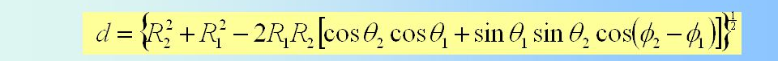

Air plane agent
Estimate remaining distance in Realtime

Slide 5
Data structure
<flightSchedule> <flightName>Paris-Berlin</flightName> <originAirport> <name>Paris Charles De Gaulle</name> <code>LFPG</code> <Latitude>49.00970</Latitude> <Longitude>2.56262</Longitude> <numberOfAirplane>10</numberOfAirplane> </originAirport> <desAirport> <name>Berlin Schoenefeld</name> <code>EDDB</code> <Latitude>52.36220</Latitude> <Longitude>13.50070</Longitude> <numberOfAirplane>10</numberOfAirplane> </desAirport> <speed>777.84</speed> <altitude>10.688</altitude> <flightType>Commercial</flightType> <wayPoints>19</wayPoints> <Latitudes> <value>49.00970</value> <value>49.86190</value> <value>50.14390</value> <value>50.62530</value> </Latitudes> <Longitudes> <value>2.56262</value> <value>4.85778</value> <value>5.37361</value> <value>6.27861</value> </Longitudes> </flightSchedule>
XML reader
Objects
Agents

Slide 6
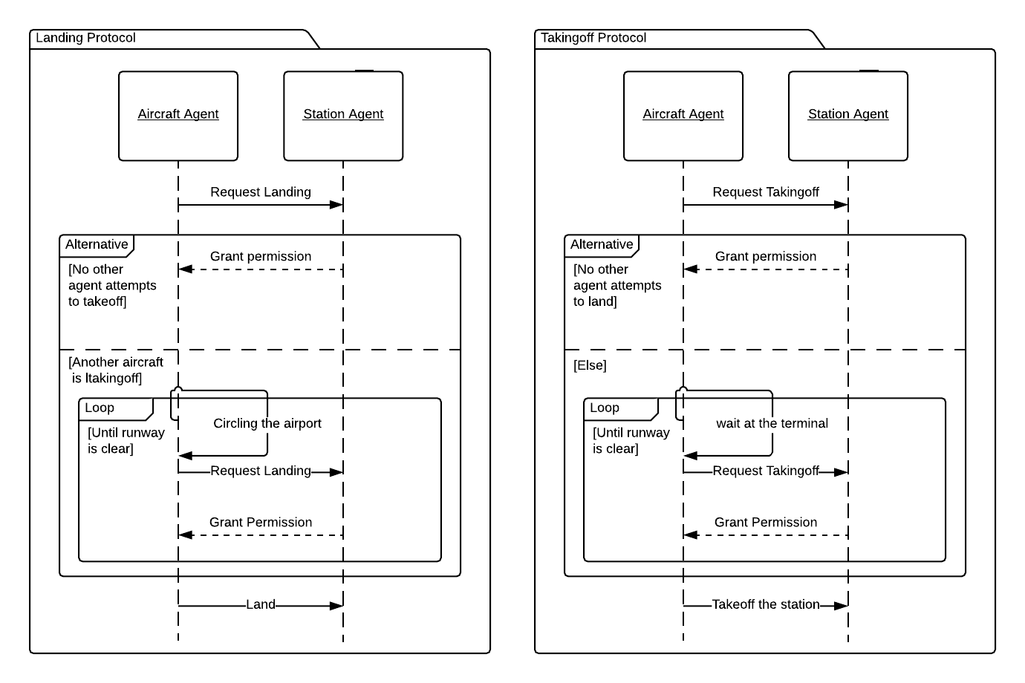
Landing / taking off protocol

Slide 7
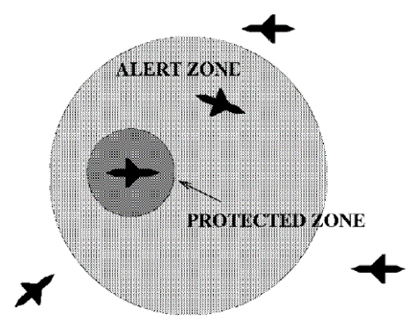
Route switching protocol
Area Proximity(true)
Increase/Decrease
Altitude
Switch to
alternative route

Slide 8
Agent interface
-Observe AirTraffic Status
-Estimate Remaining Time
-Communication between agent
-GPS information
-Label each agent

Slide 9
demo

Slide 10
Conclusion & future work
Introduce more complex scenario, increase number of agents

